Slide 1
Internet of Things with Intel A2 – IoT boards
paul.guermonprez@intel.com

Slide 2
History

Slide 3
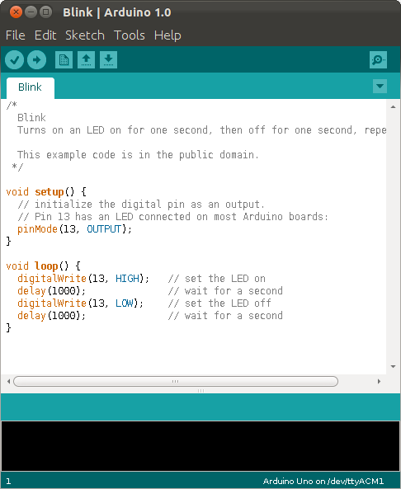
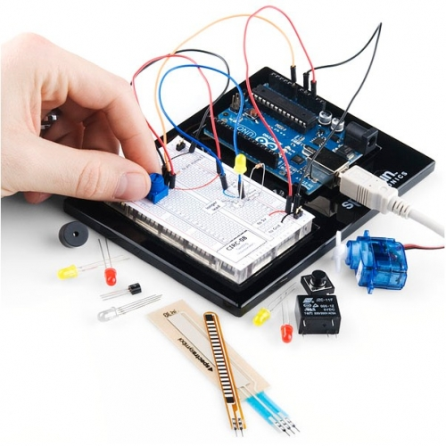
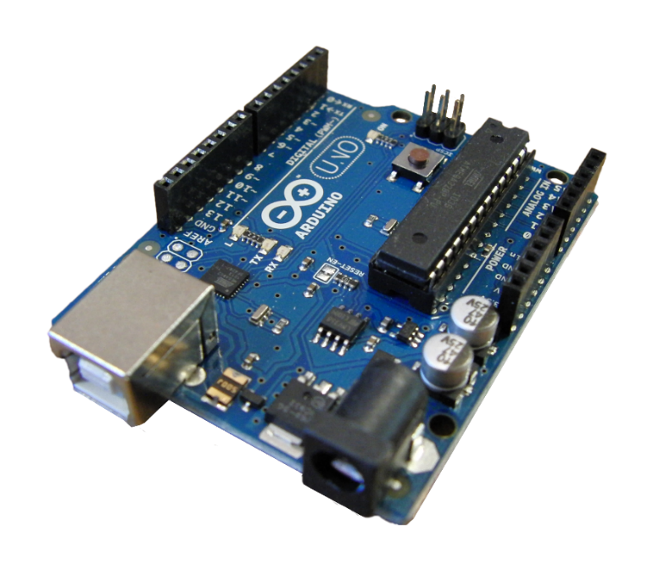
Arduino

Slide 4
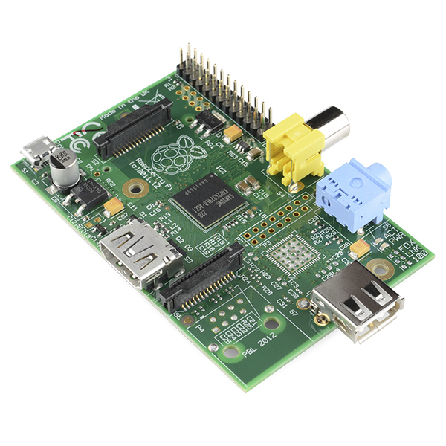
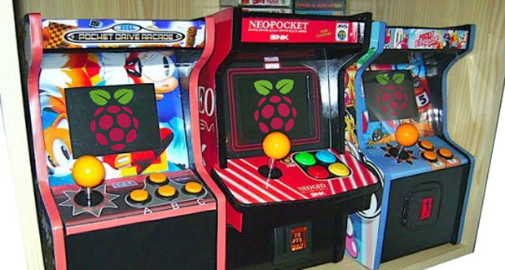
Raspberry Pi

Slide 5
Evaluation of IoT boards

Slide 6
Microcontroller vs Processor
Arduino is using a 8-bit microcontroller. It’s simple and predictable for people new to software development.
But it’s impossible to install a full system like linux, so it’s limited by nature.
To have a full OS with network, the programming language of your choice and a lot of potential, a processor is required.

Slide 7
Digital / Analog IO
If you develop on your laptop, you can only plug devices with high level IO like USB. But most IoT sensors are a lot simpler than that, using low level analog and digital IO.
To be really useful as an IoT platform, you must have digital and/or analog IO.
Note : Some IoT platforms only have digital IO, others like Intel Galileo and Intel Edison have both digital and analog IO.

Slide 8
Graphics
Many wearable projects like watches have a touch screen, or a projector for glasses. They look like a lot like small mobile devices, and require graphics.
We have such platforms at Intel.
But for all the other IoT projects, you don’t need and don’t want graphics.
Remember : display = interaction = brain attention share = not scalable.

Slide 9
Networking
Network connectivity is important in IoT.
You may take a platform without wireless internet and add a dongle for prototyping, but :
It’s harder to switch to production
Power optimizations are limited
Dongle often propose limited features : Bluetooth instead of Bluetooth Low Energy.
Integration with software-OS is not always trivial.
Advice : take platforms with great networking inside for prototyping then production.

Slide 10
Form factor
It’s convenient to have large boards with lots of IO for prototyping. But you’ll need to design a new board for production. It takes a lot of money, time and skills.
Or you take a board with a modular design : your compute module has all the complex parts you won’t redesign, and the simper connectivity board can be replaced or designed easily.

Slide 11
Power features
A big difference between IoT prototypes and production is total power consumption.
You would not plug a 3G dongle on a desktop and call it a mobile phone, right ? Same for IoT.
You need :
a very efficient processor, with advanced sleep/hibernation features
power optimized wireless
great integration of all parts
lots of software, driver and OS optimization

Slide 12
OS
We all like to prototype with our desktop OS.
It can be a big linux distro like Ubuntu, Windows 10, OSX … it’s easy, all the packages are readily available.
But a professional grade embedded project requires to start from scratch, perhaps use a substitute of glic, control each piece of code added to the system and integrate with a large team of software developers.
A typical open source OS for professional projects is Yocto.

Slide 13
Intel IoT boards

Slide 14
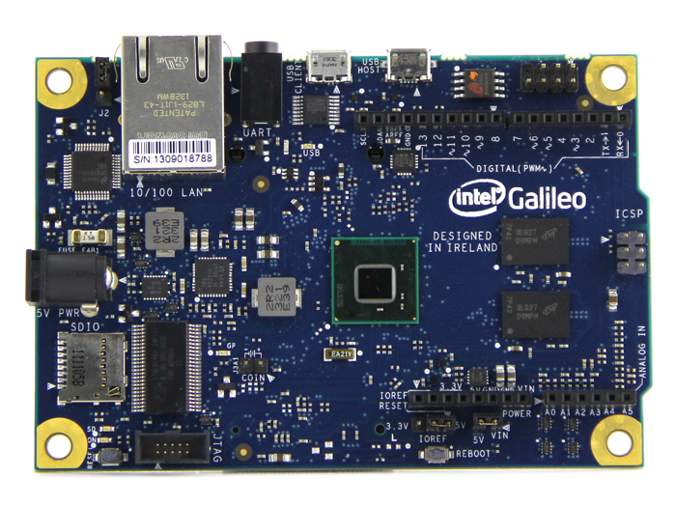
Intel Galileo

Slide 15
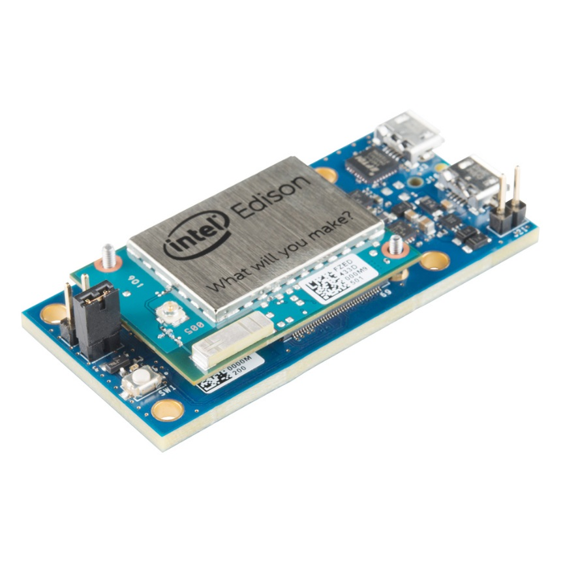
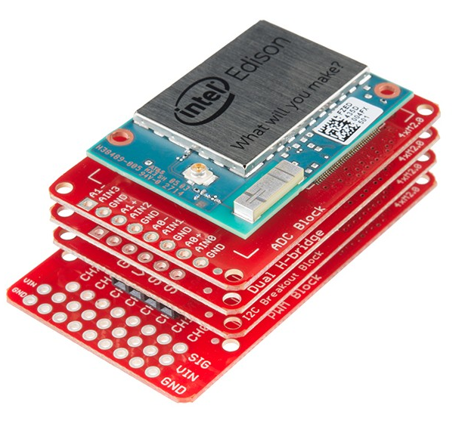
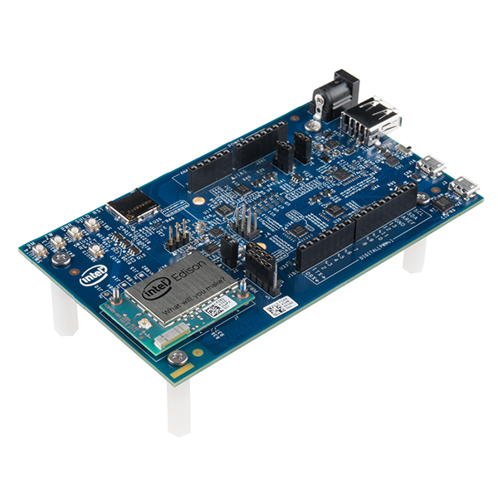
Intel Edison

Slide 16
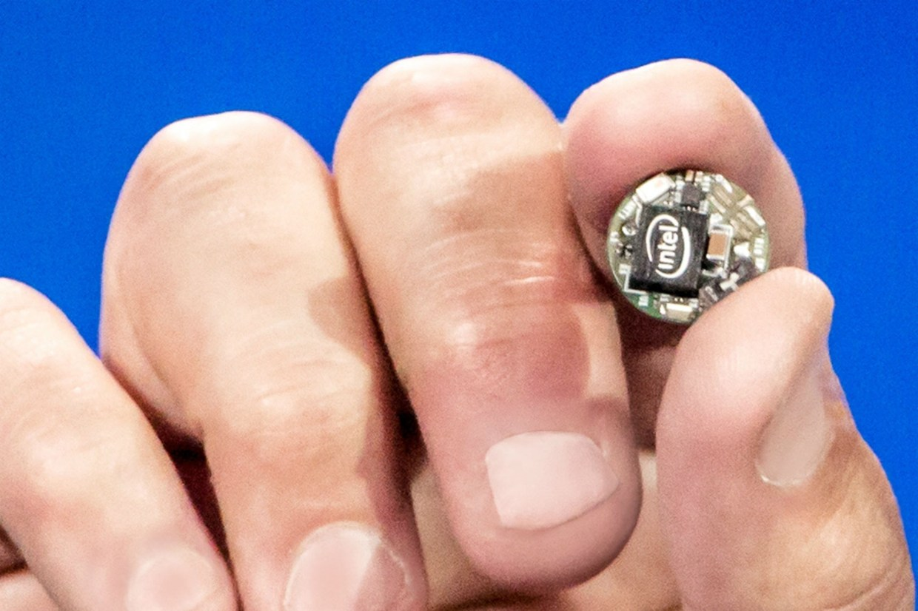
Intel Curie

Slide 17
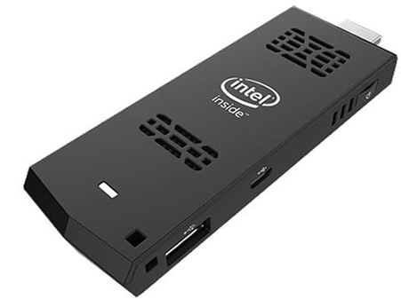
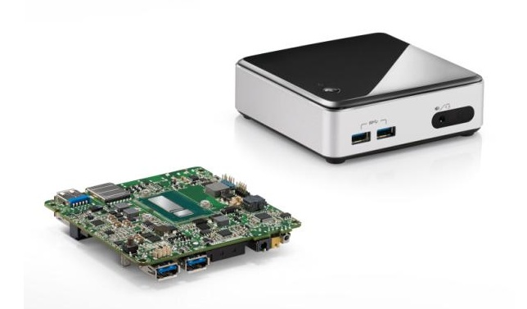
But also : HDMI Stick, NUC

Slide 18
Intel IoT boards
Intel Galileo Specifications

Slide 19
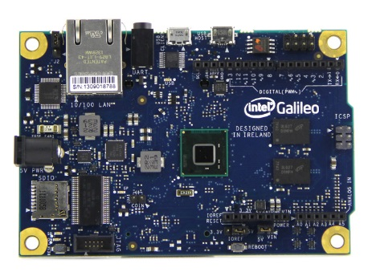
Intel Galileo Specs
Intel Quark System-on-Chip (SoC) x1000 with a 32bit core running at 400MHz.
Connections : mini-PCI Express (for Wifi-Bluetooth module), 100Mb Ethernet port, Micro-SD slot, RS-232 serial port, USB Host, USB Client.
Form factor : Arduino compatible pins.

Slide 20
Intel Galileo Specs
The board can run :
Linux Yocto by default from Intel. (Yocto is an open source linux used by embedded professionals)
Debian variant by the community.
Arduino style code by an emulator.
Windows by Microsoft.
In some cases, WindRiver solutions.

Slide 21
Intel IoT boards
Intel Edison Specifications

Slide 22

Intel Edison Specs
22 nm Intel SoC that includes :
a dual-core, dual-threaded Intel Atom CPU at 500 MHz, running linux
a 32-bit Intel Quark microcontroller at 100 MHz, running RTOS
Memory : 1 GB LPDDR3
Storage : 4 GB eMMC
Wifi : a/b/g/n
Bluetooth : 4.0 Low Energy

Slide 23
Intel Edison Specs
40 GPIO :
SD card : 1 interface
UART : 2 controllers (1 full flow, 1 Rx/Tx)
I2C : 2 controllers
SPI : 1 controller with 2 chip selects
I2S : 1 controller
GPIO : Additional 12 (with 4 capable of PWM)
USB 2.0 : 1 OTG controller
Form factor : modular. The connectivity boards are available from Intel, Sparkfun, …

Slide 24
Intel Edison Specs
The board can run :
Linux Yocto by default from Intel. (Yocto is an open source linux used by embedded professionals)
Debian variant Ubilinux by the community.
Arduino style code by an emulator.

Slide 25
Intel IoT boards
Intel Curie Specifications

Slide 26

Intel Curie Specs

Slide 27
License Creative Commons – By 3.0
You are free:
to Share — to copy, distribute and transmit the work
to Remix — to adapt the work
to make commercial use of the work
Under the following conditions:
Attribution — You must attribute the work in the manner specified by the author or licensor (but not in any way that suggests that they endorse you or your use of the work).
With the understanding that:
Waiver — Any of the above conditions can be waived if you get permission from the copyright holder.
Public Domain — Where the work or any of its elements is in the public domain under applicable law, that status is in no way affected by the license.
Other Rights — In no way are any of the following rights affected by the license:
Your fair dealing or fair use rights, or other applicable copyright exceptions and limitations;
The author's moral rights;
Rights other persons may have either in the work itself or in how the work is used, such as publicity or privacy rights.
Notice — For any reuse or distribution, you must make clear to others the license terms of this work. The best way to do this is with a link to this web page.
http://creativecommons.org/licenses/by/3.0/

